Slide 1

Data visualization, Recommendation and sentiment analysis on Netflix data
Created by
Nithin Polavarapu
Sai Chandu Aluri
Aditya Prasad Yarlagadda
Sai Prasanna Mannam

Slide 2
Abstract
The amount of data generated on social media platforms is growing as the platforms continue to expand. As a result, it's been difficult for users to evaluate the data and identify recommended movies based on their preferences.
End users can understand data by seeing it represented in graphs and plots. And a recommender system can help them to locate similar movies on the web.
This paper focuses on providing users with visualized data and designing a content-based recommendation framework to provide users with similar content movies.

Slide 3
INTRODUCTION
The amount of data generated per year is increasing at a faster rate than it has ever been. In only a year, the total amount of data on the planet would have grown to 44 zettabytes (44 trillion gigabytes)!
In today's terms, it's about 4.4 zettabytes. By 2025, the total amount of data on the planet is projected to reach 175 zettabytes.
This rapid expansion of data processing has led to a new age of data. Data is being used to develop more efficient systems and that's where recommendation systems are coming into the picture.

Slide 4


METHODOLOGY
The foundation of any machine learning project is data.
1. Data Collection
2. Data pre-processing
3. Dataset splitting

Slide 5
Data Visualization
There are several methods for visualizing data, including graphs, histograms, tables, and pie charts.
For these visualizations, we used 'Plotly’, ‘Seaborn’, ‘Matplotlib’ packages.

Slide 6
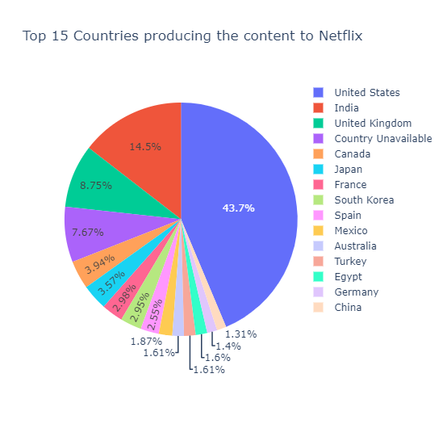
Top 15 Countries producing the content to Netflix

Slide 7
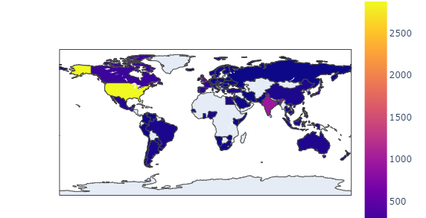
Total no of movies and tv shows released in a country

Slide 8
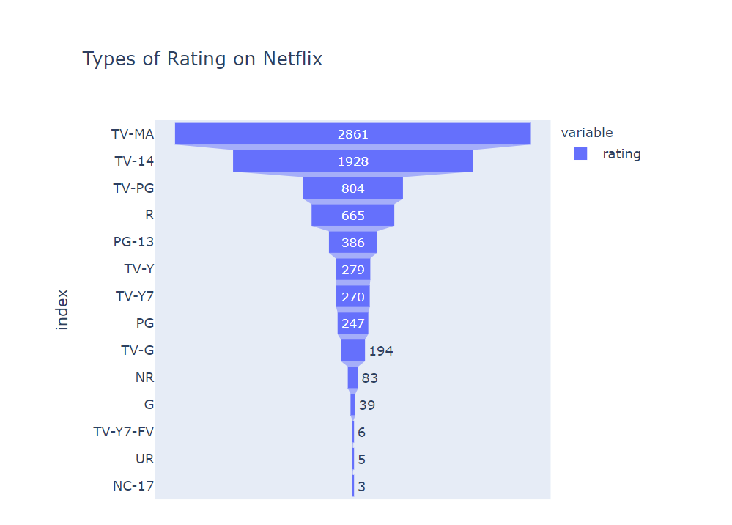
Rating Analysis
With the above data, it's difficult to say which are only applicable to Kids, Adults, etc.. because there are many ratings which are related to Kids and Adults. So better understanding for the end users, we are groping the ratings and displaying the result.

Slide 9
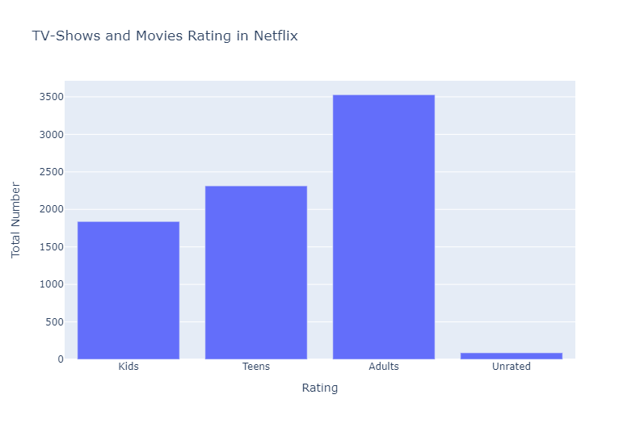
So, we grouped the ratings into 3 categories. Adults – R, NC-17, TV-MA Teens – PG-13, TV-14 Kids - TV-Y, TV-Y7, TV-Y7-FV, G, TV-G, PG, TV-PG

Slide 10
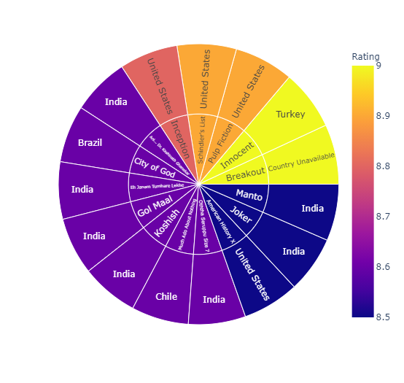
Top Countries with highest rated movie in that region

Slide 11
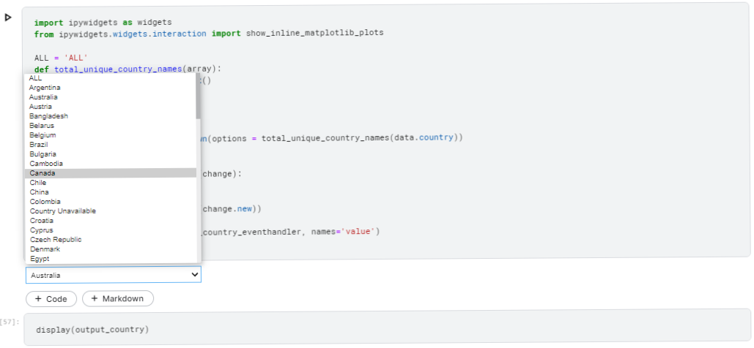
Dropdown Widget

Slide 12
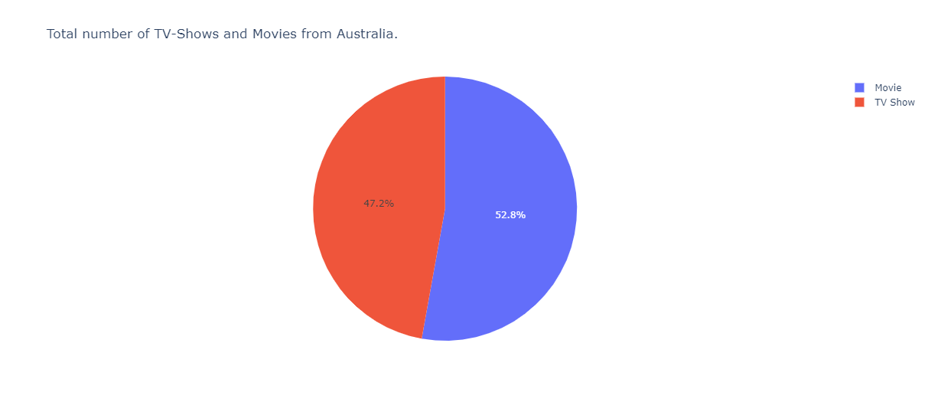

Slide 13
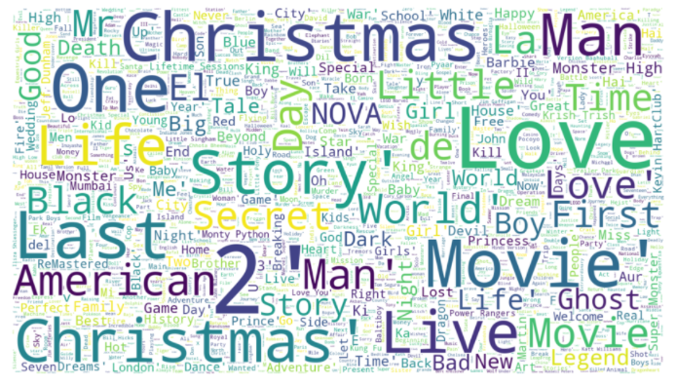
Movies Wordcloud

Slide 14
Sentiment Analysis
What is Sentiment Analysis?
What is the use of this?

Slide 15
Steps involved in the Sentiment Analysis
Firstly, importing all the necessary libraries and reading the data from IMDB Movies, then remove any duplicate titles and ratings.
We then used inner join data to combine title and rating data, and then printed the values in descending order by rating.
We then used the Polarity rating to determine the sentiment orientation; if x > 6, it is positive; otherwise, it is negative.
Then, using one hot, create dummies with negative and positive polarity ratings.
Contd..

Slide 16
As the test size is 10%, the data is then split into training and testing.
We then used CountVectorizer to convert the texts into vectors.
The model is then built using the 'relu' and 'sigmoid,' since there are only two negative and positive expressions.
The final move is to determine the accuracy.

Slide 17
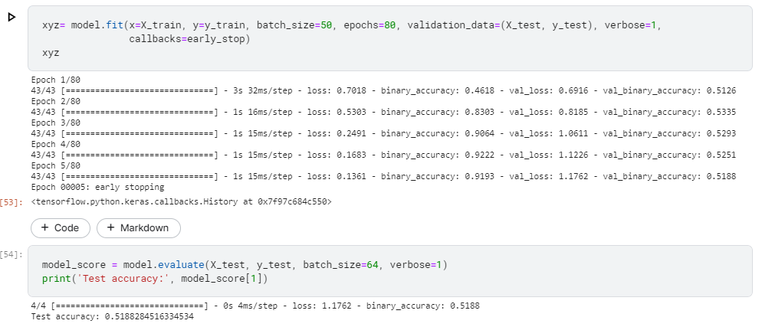
Accuracy - We got a 53% Test accuracy with the movies data.
By taking into account, the large amount of data, this can be increased even further.

Slide 18
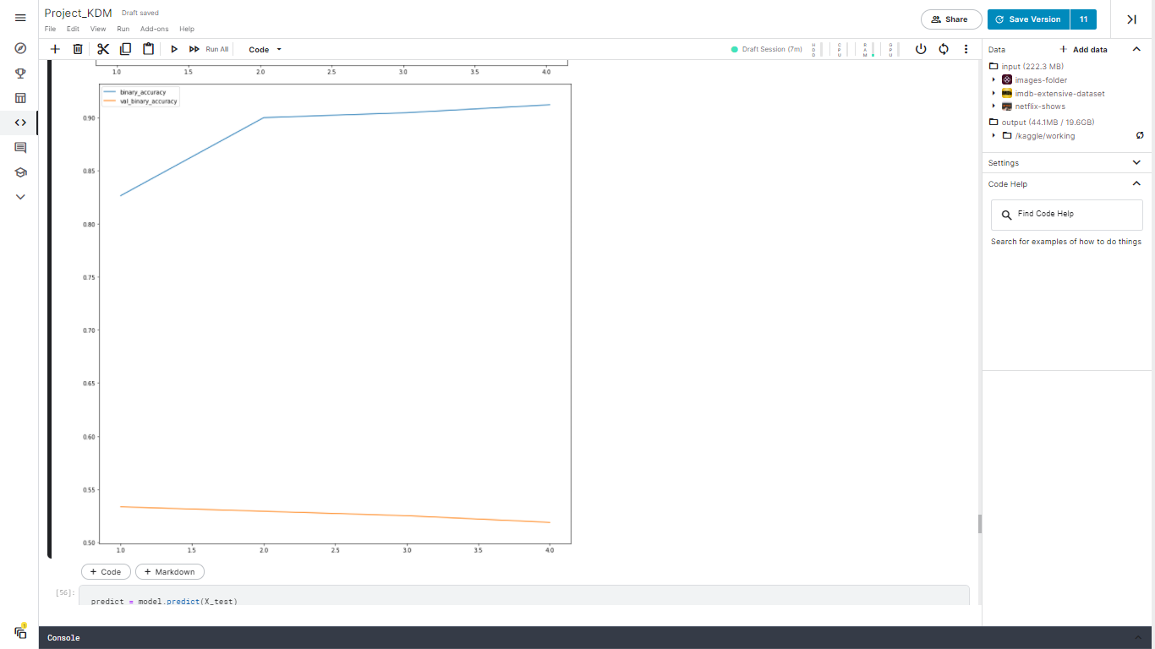
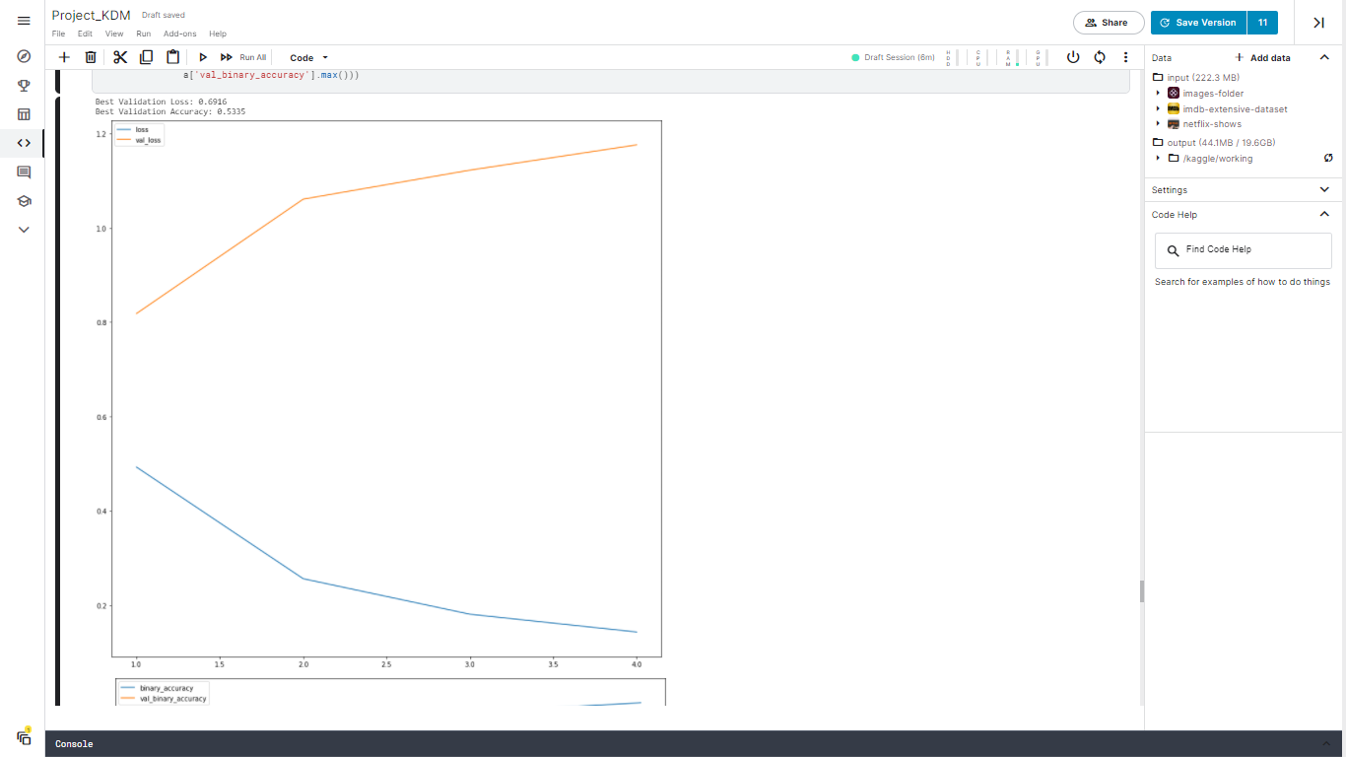

Slide 19
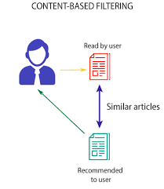
Recommendation
What are recommender systems?
What is the use of these systems?

Slide 20
Steps involved in the Recommender System
First, convert the text data to matrix form using the CountVectorizer function.
Next perform Cosine similarity on the data matrix and convert it into a list of tuples where the first element is its index and second is the similarity score.
Sort the tuples based on the highest similarity score.
After that, get the Index of the movie which user wants recommendations.
Then pass the Index value to Cosine similarity matrix that we calculated above.
Finally, return the top 10 movies which have similar cosine value.

Slide 21
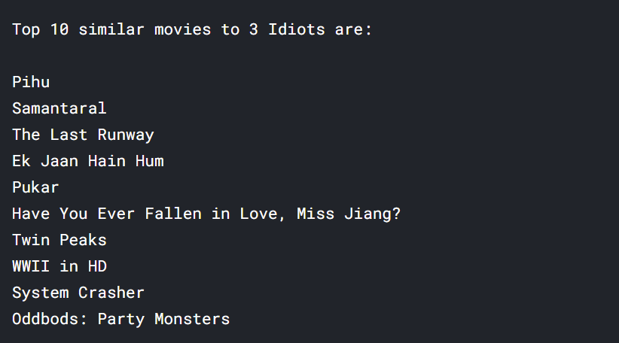

Slide 22
CONCLUSION
To summarize, we used several data visualizations to better understand the content and then suggested a framework to end users based on their preferences.
We also ran sentiment analysis on the data, breaking it into training and testing datasets and feeding them into the sequential model, before calculating the data's accuracy.
We got a 52 percent accuracy for this data. By taking into account the large amount of data, this can be increased even further.

Slide 23
Thank you!

